Slide 1
Machine Learning DSECL ZG565
Dr. Chetana Gavankar, Ph.D,
IIT Bombay-Monash University Australia
Chetana.gavankar@pilani.bits-pilani.ac.in

Slide 2
Lecture No. – 4 | Naïve Bayes Classifier
Date – 20/09/2020
Time – 1:55 PM – 4:00 PM

Slide 3
Session Content
Quick recap
Probabilistic Generative Classifiers
Bayes optimal classifier (T1 book by Tom Mitchell - 6.7)
Gibbs Algorithm (T1 book by Tom Mitchell - 6.8)
Naïve Bayes Classifier (T1 book by Tom Mitchell - 6.9)
Text classification model (T1 book by Tom Mitchell - 6.9)
Image classification

Slide 4
Hypothesis
Relationship between the input and output values.
Lets say that target function y=f(x) However, f(.) is unknown function to us.
Machine learning algorithms try to guess a hypothesis function h(x) that approximates the unknown f(.)
Set of all possible hypotheses is known as the Hypothesis set or space H(.)
Goal is the learning process is to find the final hypothesis that best approximates the unknown target function.

Slide 5
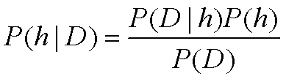
Bayes Theorem
P(h) = prior probability of hypothesis h
P(D) = prior probability of training data D
P(h|D) = probability of h given D
P(D|h) = probability of D given h

Slide 6
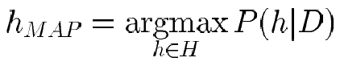
Brute Force MAP Hypothesis
For each hypothesis h in H, calculate the posterior probability
Output the hypothesis h_{MAP} with the highest posterior probability

Slide 7
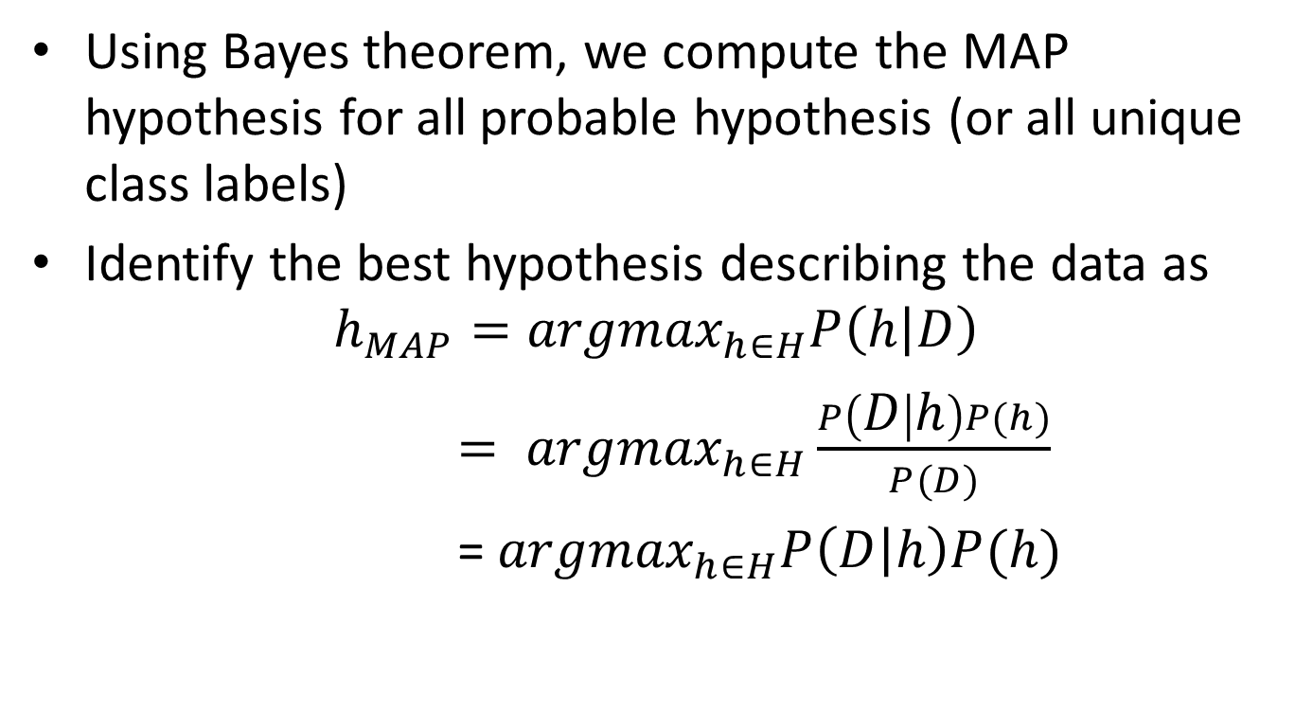
MAP Hypothesis
Using Bayes theorem, we compute the MAP hypothesis for all probable hypothesis (or all unique class labels)
Identify the best hypothesis describing the data as
$$h_{MAP}={argmax}_{h∈H}P\left(h | D\right)$$
$= {argmax}_{h∈H}\frac{P\left(D | h\right)P(h)}{P(D)}$
= ${argmax}_{h∈H}P\left(D | h\right)P(h)$
P(D) is independent of h and is same for all hypothesis, therefore dropped
H: set of all hypothesis

Slide 8
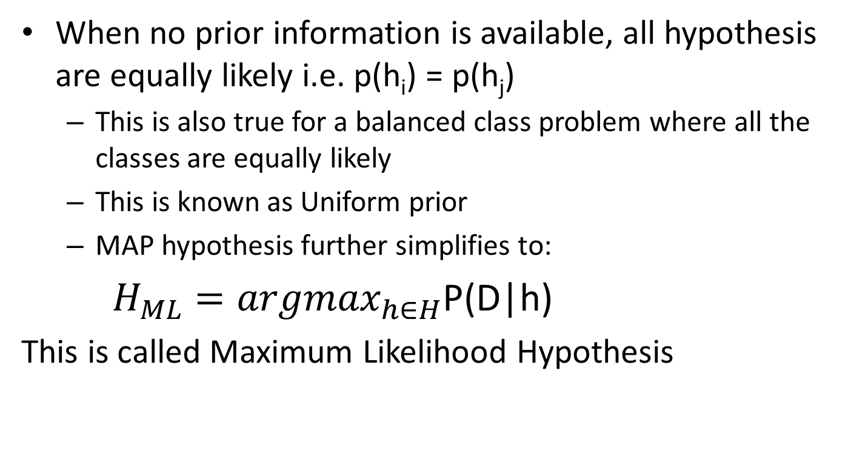
Maximum Likelihood estimation
When no prior information is available, all hypothesis are equally likely i.e. p(h_{i}) = p(h_{j})
This is also true for a balanced class problem where all the classes are equally likely
This is known as Uniform prior
MAP hypothesis further simplifies to:
${H_{ML}=argmax}_{h∈H}$P(D|h)
This is called Maximum Likelihood Hypothesis

Slide 9
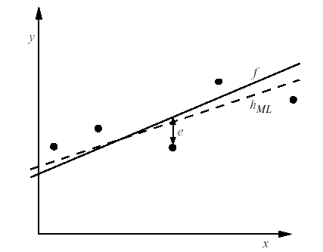
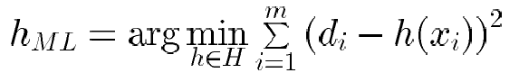
Learning A Real Valued Function
Consider any real-valued target function f
Training examples <x_{i}, d_{i}>, where d_{i} is noisy training value
d_{i} = f(x_{i}) + e_{i}
e_{i} is random variable (noise) drawn independently for each x_{i} according to some Gaussian distribution with mean=0
Then the maximum likelihood hypothesis h_{ML} is the one that minimizes
the sum of squared errors:

Slide 10
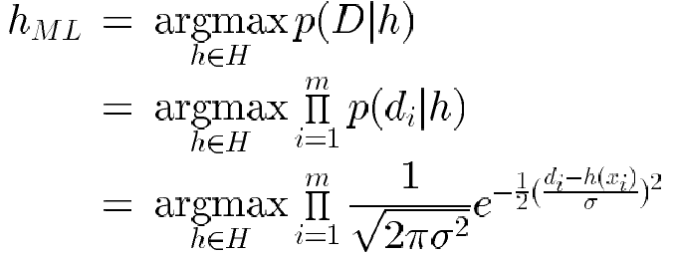
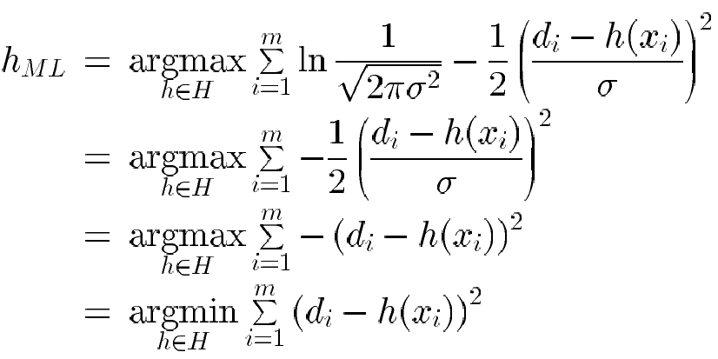
Learning A Real Valued Function
Maximize natural log of this instead...

Slide 11
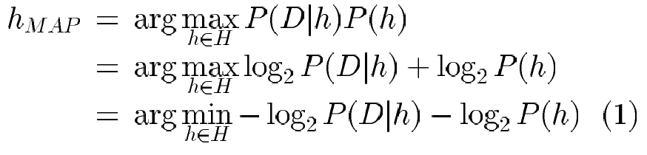
Minimum Description Length Principle
Interesting fact from information theory:
The optimal (shortest expected coding length) code for an event with
probability p is –log₂p bits.
So interpret (1):
L_{C1}(h) = length(h) = –log₂P(h)
L_{C2}(D|h)= length(misclassifications) = –log₂P(D|h)
→ prefer the hypothesis that minimizes
length(h) + length(misclassifications)

Slide 12
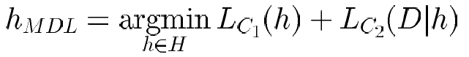
Minimum Description Length Principle
Occam’s razor: prefer the shortest hypothesis
MDL: prefer the hypothesis h that minimizes
where L_{C}(x) is the description length of x under encoding C

Slide 13
Minimum Description Length Principle
MDL principle provides a way of trading off hypothesis complexity for the number of errors committed by the hypothesis.
May select a shorter hypothesis that makes a few errors over a longer hypothesis that perfectly classifies the training data.
Provides one method for dealing with the issue of overfitting the data.

Slide 14
Most Probable Classification of New Instances
So far we’ve sought the most probable hypothesis given the data D (i.e., h_{MAP})
Given new instance x, what is its most probable classification?
h_{MAP}(x) is not the most probable classification!
Consider:
Three possible hypotheses:
P(h₁|D) = .4, P(h₂|D) = .3, P(h₃|D) = .3
Given new instance x,
h₁(x) = +, h₂(x) = −, h₃(x) = −
What’s most probable classification of x?

Slide 15
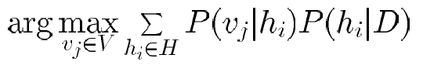
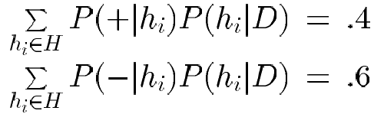
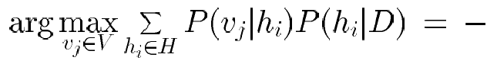
Bayes Optimal Classifier
Bayes optimal classification:
Example:
P(h₁|D) = .4, P(−|h₁) = 0, P(+|h₁) = 1
P(h₂|D) = .3, P(−|h₂) = 1, P(+|h₂) = 0
P(h₃|D) = .3, P(−|h₃) = 1, P(+|h₃) = 0
therefore
and

Slide 16
Gibbs Classifier
Bayes optimal classifier provides best result, but can be expensive if many hypotheses.
Gibbs algorithm:
1. Choose one hypothesis at random, according to P(h|D)
2. Use this to classify new instance
Surprising fact: Assume target concepts are drawn at random from H according to priors on H. Then:
E[error_{Gibbs}] ≤ 2E [error_{BayesOptional}]
Suppose correct, uniform prior distribution over H, then
Pick any hypothesis from VS, with uniform probability
Its expected error no worse than twice Bayes optimal

Slide 17
ML setting
Bayesian Analysis
start with some belief about the system, called a prior.
Then we obtain some data and use it to update our belief.
The outcome is called a posterior.

Slide 18
ML Setting
P(h | D) a posterior determines the class label
It’s a probability distribution over model parameters obtained from prior beliefs and data.
When one uses likelihood to get point estimates of model parameters, it’s called Maximum Likelihood estimation or MLE.
If one also takes the prior into account, then it’s maximum a posteriori estimation (MAP).
MLE and MAP are the same if the prior is uniform
This forms the basis for Naïve Bayes classifier

Slide 19
Bayesian Learning
Bayesian learning algorithms that calculate explicit probabilities for hypotheses, such as the naive Bayes classifier, are among the most practical approaches to certain types of learning problems
For example: Problem of learning to classify text documents such as electronic news articles.
For such learning tasks, the naive Bayes classifier is among the most effective algorithms known

Slide 20
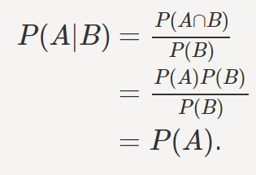
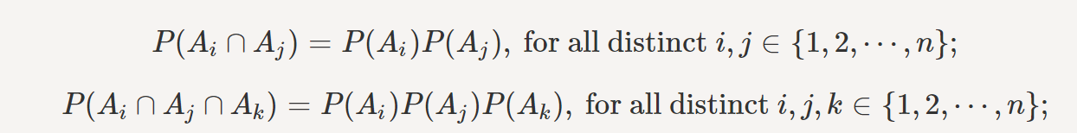
Independence
Two events A and B are independent if and only if P(A∩B)=P(A)P(B).
if two events A and B are independent then P(A|B)=P(A)
In general, for n events A1,A2,⋯,An to be independent we must have

Slide 21
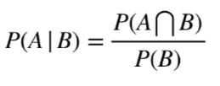
Conditional Probability
Conditional Probability is a measure of the probability of an event given that another event has already occurred.
If the event of interest is A and the event B is known or assumed to have occurred.
This probability is written P(A|B), notation for the probability of A given B.

Slide 22
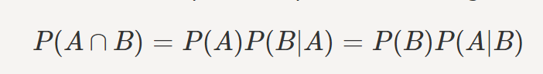
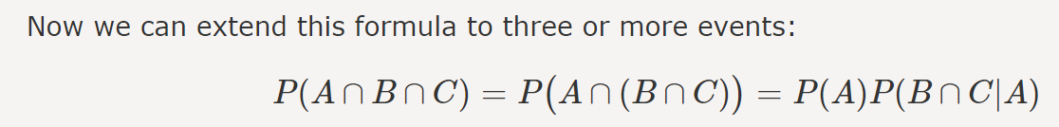
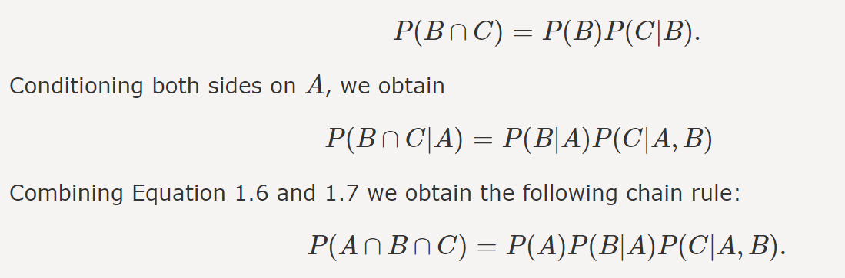
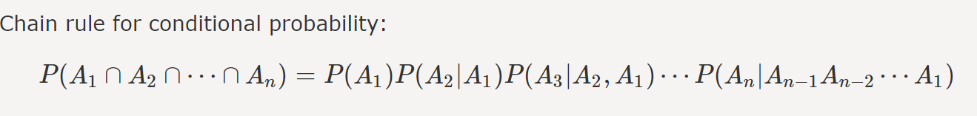
Chain Rule for Conditional Probability
https://www.probabilitycourse.com/chapter1/1_4_0_conditional_probability.php

Slide 23
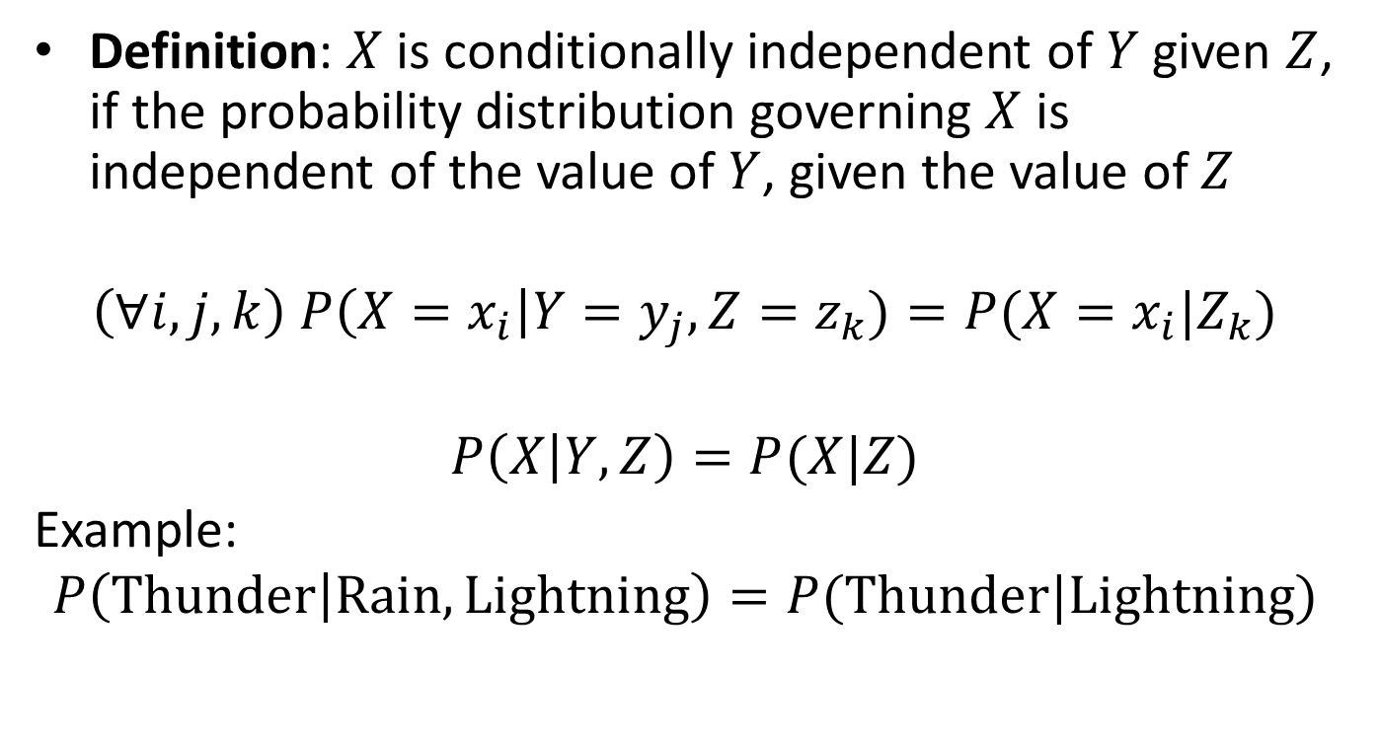
Conditional independence
Definition: $X$ is conditionally independent of $Y$ given $Z$, if the probability distribution governing $X$ is independent of the value of $Y$, given the value of $Z$
$$\left(∀i,j,k\right) P\left(X=x_{i}\right|Y=y_{j}, Z=z_{k})=P(X=x_{i}|Z_{k})$$
$$P\left(X | Y, Z\right)=P(X|Z)$$
Example:
$$P\left(Thunder | Rain, Lightning\right)=P(Thunder|Lightning)$$

Slide 24
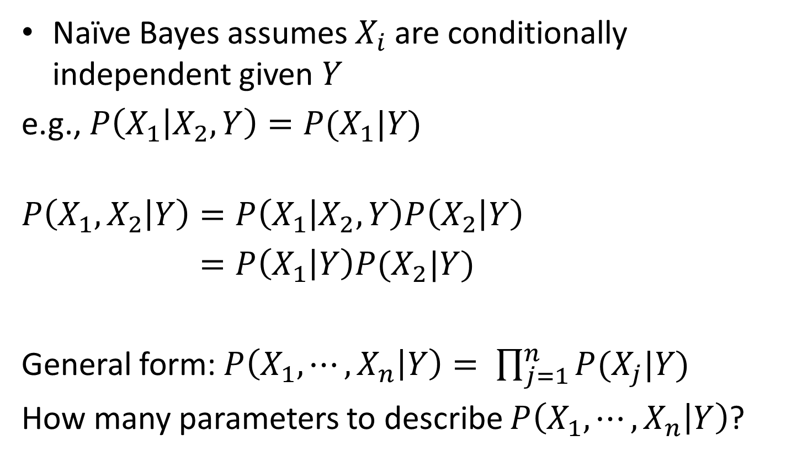
Applying conditional independence
Naïve Bayes assumes $X_{i}$are conditionally independent given $Y$
e.g., $P\left(X_{1} | X_{2}, Y\right)=P(X_{1}|Y)$
$$P\left(X_{1}, X_{2} | Y\right)=P\left(X_{1} | X_{2},Y\right)P\left(X_{2} | Y\right)$$
$=P\left(X_{1} | Y\right)P(X_{2}|Y)$
General form: $P\left(X_{1}, ⋯,X_{n} | Y\right)= \prod_{j=1}^{n}{P(X_{j}|Y)}$
How many parameters to describe $P\left(X_{1}, ⋯,X_{n} | Y\right)$?

Slide 25
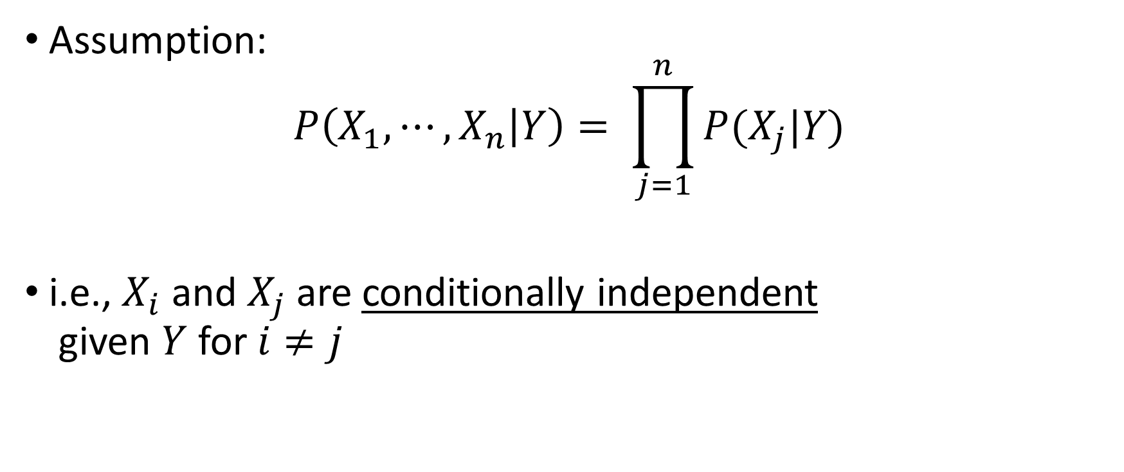
Naïve Bayes Independence assumption
Assumption:
$$P\left(X_{1}, ⋯,X_{n} | Y\right)= \prod_{j=1}^{n}{P(X_{j}|Y)}$$
i.e., $X_{i}$ and $X_{j}$ are conditionally independent given $Y$ for $i≠j$

Slide 26
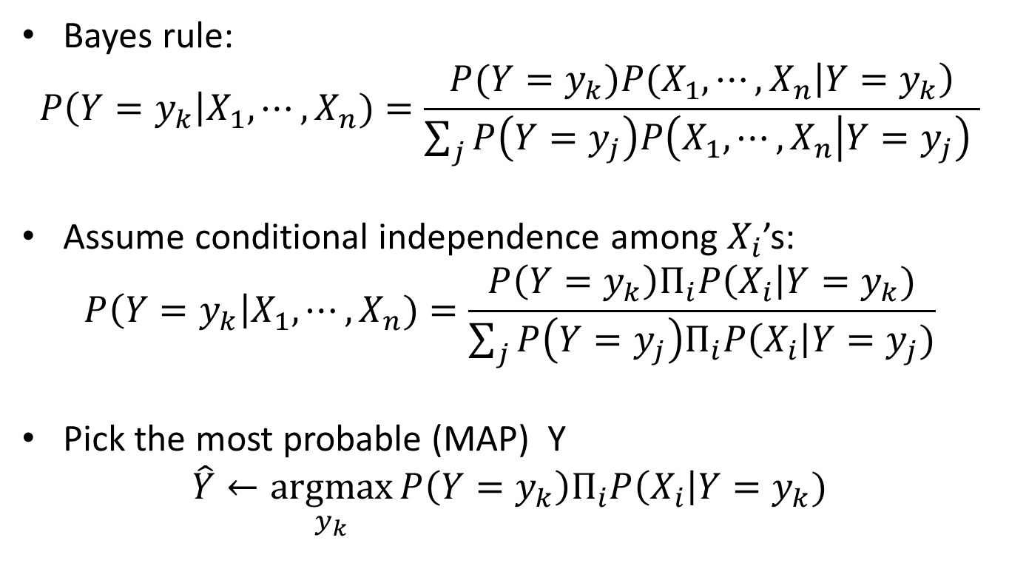
Naïve Bayes classifier
Bayes rule:
$$P\left(Y=y_{k}\right|X_{1}, ⋯,X_{n})=\frac{{P(Y=y_{k})P(X_{1},⋯,X}_{n}\left|Y=y_{k}\right)}{\sum_{j}{P\left(Y=y_{j}\right)P\left(X_{1},⋯, X_{n} | Y=y_{j}\right) }}$$
Assume conditional independence among $X_{i}$’s:
$$P\left(Y=y_{k}\right|X_{1}, ⋯,X_{n})=\frac{P\left(Y=y_{k}\right)Π_{i}P\left(X_{i}\right|Y=y_{k})}{\sum_{j}{P\left(Y=y_{j}\right)Π_{i}P\left(X_{i}\right|Y=y_{j})}}$$
Pick the most probable (MAP) Y
$$\hat{Y}←\underset{y_{k}}{argmax}{P\left(Y=y_{k}\right)Π_{i}P\left(X_{i}\right|Y=y_{k})}$$
Prior Probability
MLE

Slide 27
NAÏVE BAYES CLASSIFIER
Assume independence among attributes X_{i} when class is given:
P(X₁, X₂, …, X_{d} |Y_{j}) = P(X₁| Y_{j}) P(X₂| Y_{j})… P(X_{d}| Y_{j})
Now we can estimate P(X_{i}| Y_{j}) for all X_{i} and Y_{j} combinations from the training data
New point is classified to Y_{j} if P(Y_{j}) Π P(X_{i}| Y_{j}) is maximal.
Slide adopted from “Introduction to Data mining” Vipin Kumar

Slide 28
Naïve Bayes Classifier – Example 1
A: attributes
M: mammals
N: non-mammals
P(A|M)P(M) > P(A|N)P(N)
=> Mammals

Slide 29
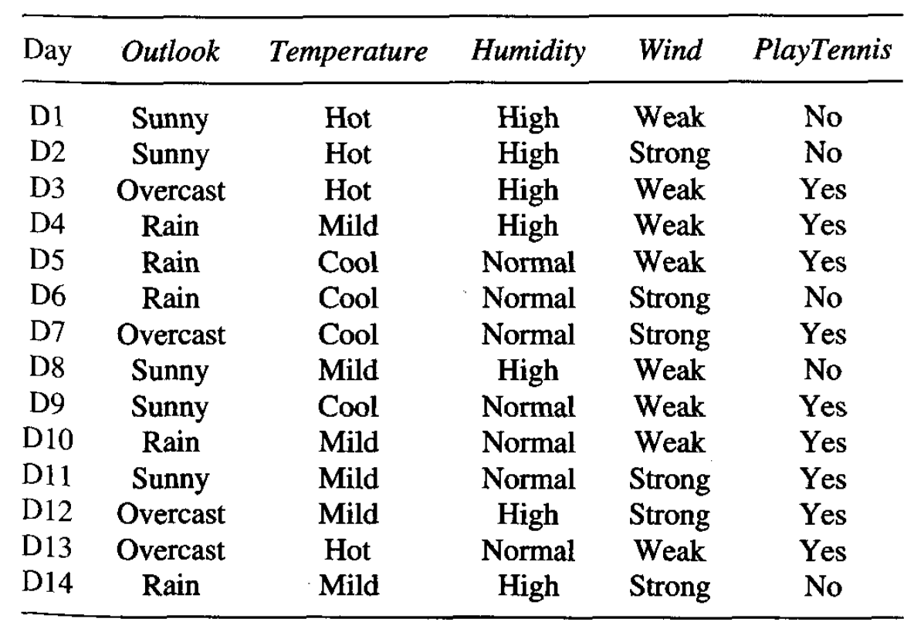
Naïve Bayes Classifier – Example 2
Use case is to predict the chances of playing tennis given a few parameters
Weather outlook
Temperature
Humidity
Wind
Data is given
for 14 days

Slide 30
Naïve Bayes Classifier – Example 2
New input set to be classified is –
{Outlook = sunny, Temperature = cool, Humidity = high, Wind = strong}
Output parameter (PlayTennis) has 2 classes – Yes, No
Step-1 Calculate conditional probabilities of each input parameter given each of the classes (likelihood)
P(Outlook=sunny | PlayTennis=yes) = 2 / 9
P(Outlook=sunny | PlayTennis=no) = 3 / 5
P(Temp=cool | PlayTennis=yes) = 3 / 9
P(Temp=cool | PlayTennis=no) = 1 / 5
P(Humidity=high | PlayTennis=yes) = 3 / 9
P(Humidity=high | PlayTennis=no) = 4 / 5
P(Wind=strong | PlayTennis=yes) = 3 / 9
P(Wind=strong | PlayTennis=no) = 3 / 5
Step-2 Calculate total probability of each of the classes (prior)
P(PlayTennis=yes) = 9/14
P(PlayTennis=no) = 5/14

Slide 31
Naïve Bayes Classifier – Example 2
Step-3 Calculate probability for each class given the input conditions in new input set (posterior)
P(PlayTennis=yes | Outlook=sunny, Temp=cool, Humidity=high, Wind=strong)
= P(yes). P(sunny | yes). P(cool | yes). P(high | yes). P(strong | yes)
= 9/14 * 2/9 * 3/9 * 3/9 * 3/9 = 0.00529
P(PlayTennis=no | Outlook=sunny, Temp=cool, Humidity=high, Wind=strong)
= P(no). P(sunny | no). P(cool | no). P(high | no). P(strong | no)
= 5/14 * 3/5 * 1/5 * 4/5 * 3/5 = 0.02057
Using Naïve Bayes classifier, argmax (P) = no, which mean the classier assign PlayTennis = No

Slide 32
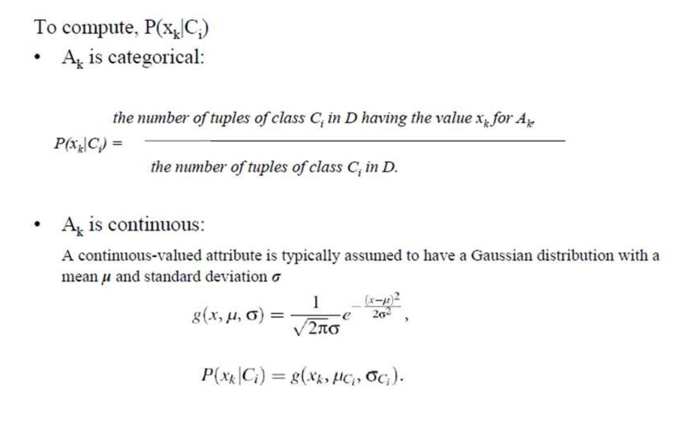
Discrete and Continuous value attributes

Slide 33
Estimate Probabilities from Continuous Data
Tid | Refund | Marital Status | Taxable Income | Evade
1 | Yes | Single | 125K | No
2 | No | Married | 100K | No
3 | No | Single | 70K | No
4 | Yes | Married | 120K | No
5 | No | Divorced | 95K | Yes
6 | No | Married | 60K | No
7 | Yes | Divorced | 220K | No
8 | No | Single | 85K | Yes
9 | No | Married | 75K | No
10 | No | Single | 90K | Yes
Normal distribution:
One for each (A_{i},c_{i}) pair
For (Income, Class=No):
If Class=No
sample mean = 110
sample variance = 3179.16

Slide 34
Example of Naïve Bayes Classifier
Given a Test Record:
Tid | Refund | Marital Status | Taxable Income | Evade
1 | Yes | Single | 125K | No
2 | No | Married | 100K | No
3 | No | Single | 70K | No
4 | Yes | Married | 120K | No
5 | No | Divorced | 95K | Yes
6 | No | Married | 60K | No
7 | Yes | Divorced | 220K | No
8 | No | Single | 85K | Yes
9 | No | Married | 75K | No
10 | No | Single | 90K | Yes
P(X|Class=No) = P(Refund=No|Class=No) × P(Married| Class=No) × P(Income=120K| Class=No) = 4/7 × 4/7 × 0.0069 = 0.0023
P(X|Class=Yes) = P(Refund=No| Class=Yes) × P(Married| Class=Yes) × P(Income=120K| Class=Yes) = 1 × 0 × 1.2 × 10⁻⁹ = 0
Since P(X|No)P(No) > P(X|Yes)P(Yes)
Therefore P(No|X) > P(Yes|X) => Class = No

Slide 35
Issues with Naïve Bayes Classifier
Consider the table with Tid = 6 deleted
Naïve Bayes Classifier:
P(Refund = Yes | No) = 2/6
P(Refund = No | No) = 4/6
P(Refund = Yes | Yes) = 0
P(Refund = No | Yes) = 1
P(Marital Status = Single | No) = 2/6
P(Marital Status = Divorced | No) = 0
P(Marital Status = Married | No) = 4/6
P(Marital Status = Single | Yes) = 2/3
P(Marital Status = Divorced | Yes) = 1/3
P(Marital Status = Married | Yes) = 0/3
For Taxable Income:
If class = No: sample mean = 91
sample variance = 685
If class = No: sample mean = 90
sample variance = 25
Given X = (Refund = Yes, Divorced, 120K)
P(X | No) = 2/6 X 0 X 0.0083 = 0
P(X | Yes) = 0 X 1/3 X 1.2 X 10⁻⁹ = 0
Naïve Bayes will not be able to classify X as Yes or No!
Slide adopted from “Introduction to Data mining” Vipin Kumar

Slide 36
Issues with Naïve Bayes Classifier
If one of the conditional probabilities is zero, then the entire expression becomes zero
Need to use other estimates of conditional probabilities than simple fractions
Probability estimation:
c: number of classes
p: prior probability of the class
m: parameter N_{c}: number of instances in the class N_{ic}: number of instances having attribute value A_{i} in class c
Slide adopted from “Introduction to Data mining” Vipin Kumar

Slide 37
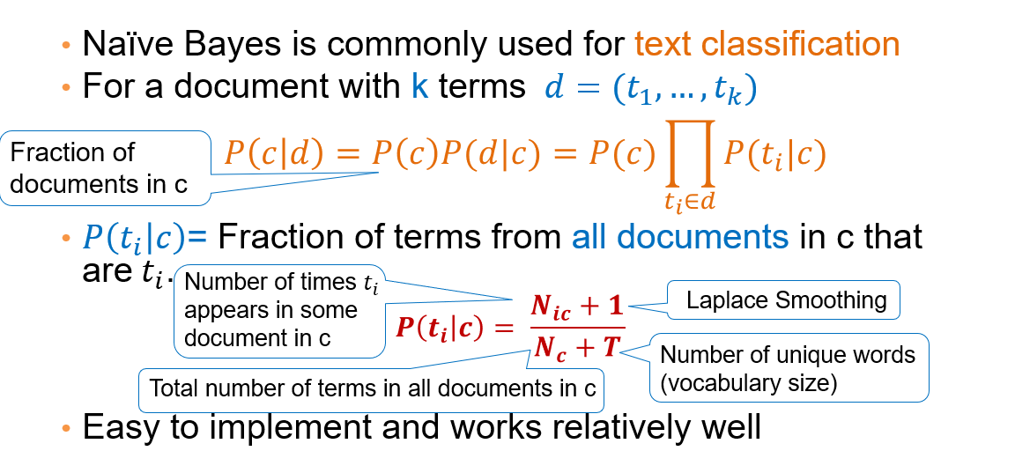
Naïve Bayes for Text Classification

Slide 38
A Simple Example
Text | Tag
“A great game” | Sports
“The election was over” | Not sports
“Very clean match” | Sports
“A clean but forgettable game” | Sports
“It was a close election” | Not sports
Which tag does the sentence A very close game belong to? i.e. P(sports| A very close game)
Feature Engineering: Bag of words i.e use word frequencies without considering order
Using Bayes Theorem:
P(sports| A very close game)
= P(A very close game| sports) P(sports)
----------------------------------------------
P(A very close game)
We assume that every word in a sentence is independent of the other ones
“close” doesn’t appear in sentences of sports tag, So P(close | sports) = 0, which makes product 0

Slide 39
Laplace smoothing
Laplace smoothing: we add 1 or in general constant k to every count so it’s never zero.
To balance this, we add the number of possible words to the divisor, so the division will never be greater than 1
In our case, the possible words are ['a', 'great', 'very', 'over', 'it', 'but', 'game', 'election', 'clean', 'close', 'the', 'was', 'forgettable', 'match'].

Slide 40
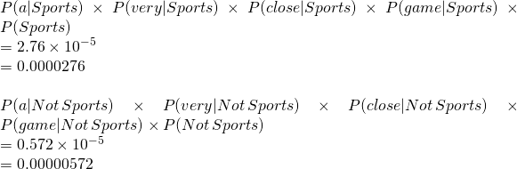
Apply Laplace Smoothing
Word | P(word | Sports) | P(word | Not Sports)
a | 2+1 / 11+14 | 1+1 / 9+14
very | 1+1 / 11+14 | 0+1 / 9+14
close | 0+1 / 11+14 | 1+1 / 9+14
game | 2+1 / 11+14 | 0+1 / 9+14

Slide 41
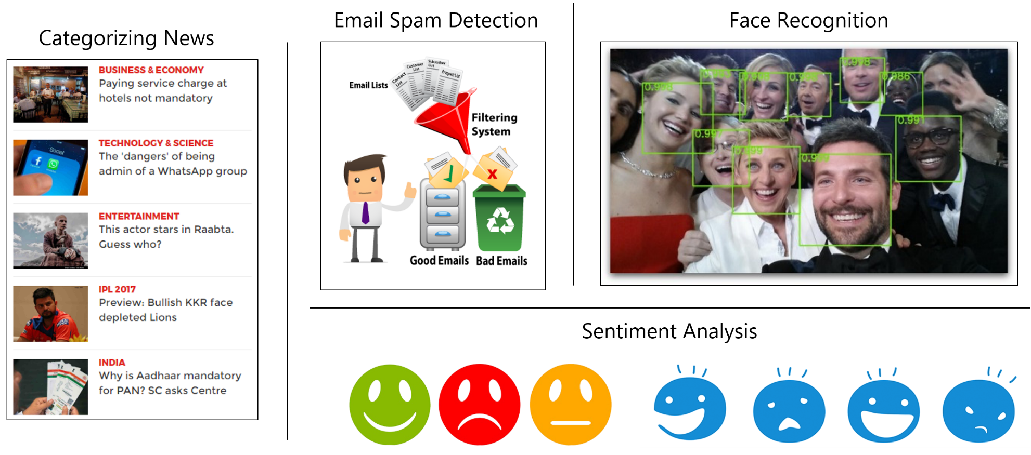
Naïve Bayes Classifier Applications

Slide 42
Naive Bayes Classifier
Along with decision trees, neural networks, one of the most practical learning methods.
When to use
Moderate or large training set available
Attributes that describe instances are conditionally independent given classification
Successful applications:
Diagnosis
Classifying text documents

Slide 43
Learning to Classify Text
Why?
Learn which news articles are of interest
Learn to classify web pages by topic
Naive Bayes is among most effective algorithms
What attributes shall we use to represent text documents??

Slide 44
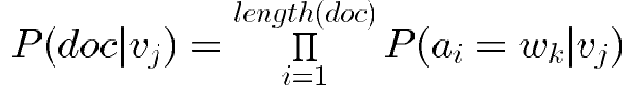
Learning to Classify Text (2/4)
Target concept Interesting? : Document →{+, −}
1. Represent each document by vector of words
one attribute per word position in document
2. Learning: Use training examples to estimate
P(+) − P(−)
P(doc|+) − P(doc|−)
Naive Bayes conditional independence assumption
where P(a_{i} = w_{k} | v_{j}) is probability that word in position i is
w_{k}, given v_{j}
one more assumption:

Slide 45
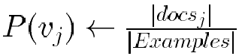
Learning to Classify Text (3/4)
LEARN_NAIVE_BAYES_TEXT (Examples, V)
1. collect all words and other tokens that occur in Examples
Vocabulary ← all distinct words and other tokens in Examples
2. calculate the required P(v_{j}) and P(w_{k} | v_{j}) probability terms
For each target value v_{j} in V do
docs_{j} ← subset of Examples for which the target value is v_{j}
Text_{j} ← a single document created by concatenating all members of docs_{j}

Slide 46
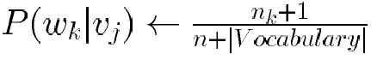
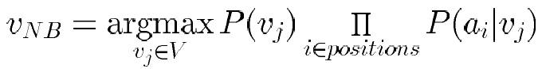
Learning to Classify Text (4/4)
n ← total number of words in Text_{j} (counting duplicate words multiple times)
for each word w_{k} in Vocabulary
* n_{k} ← number of times word w_{k} occurs in Text_{j}
*
CLASSIFY_NAIVE_BAYES_TEXT (Doc)
positions ← all word positions in Doc that contain tokens found in Vocabulary
Return v_{NB} where

Slide 47

Baseline: Bag of Words Approach
aardvark 0
about 2
all 2
Africa 1
apple 0
anxious 0
...
gas
...
oil
… Zaire
1
1
0

Slide 48
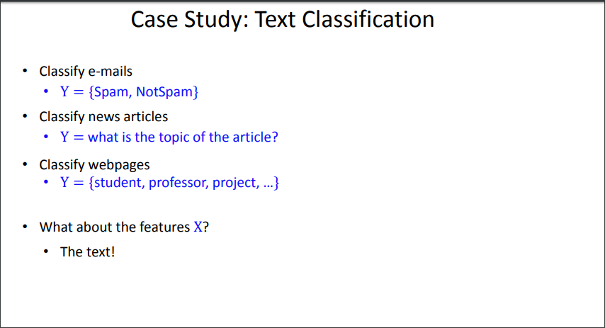

Slide 49
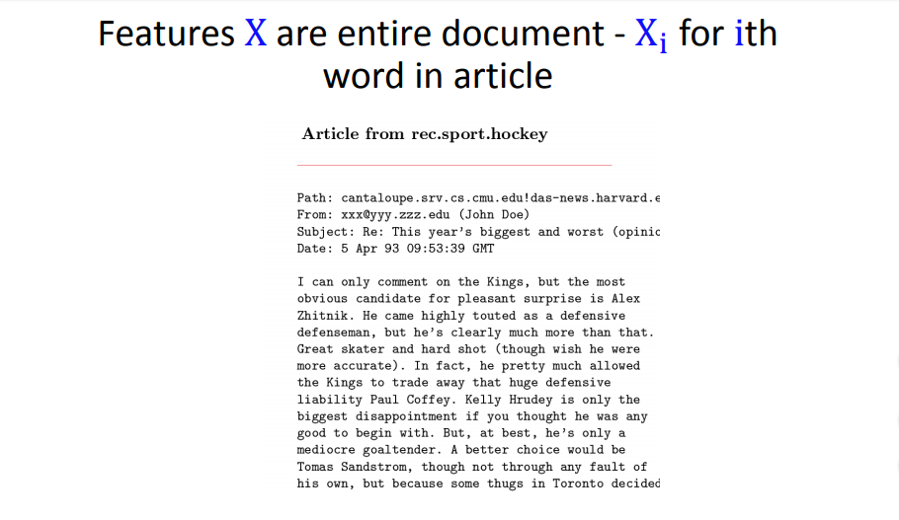

Slide 50
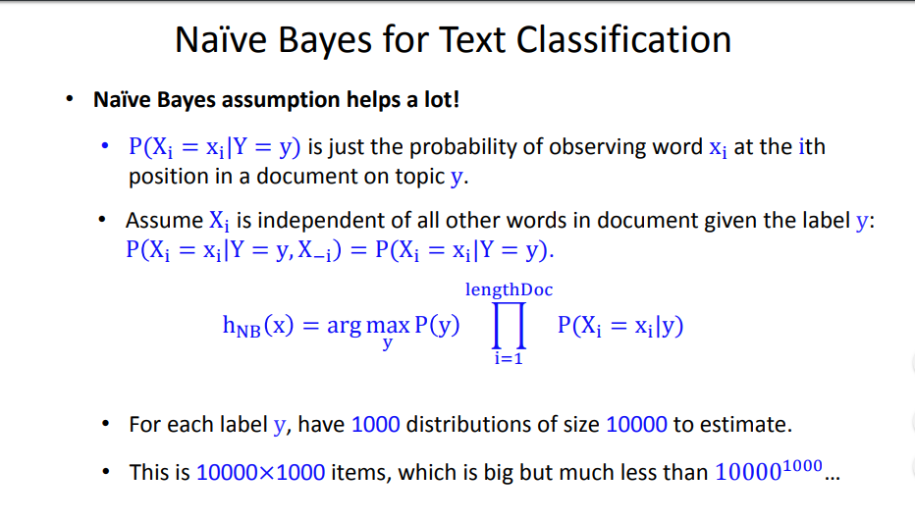

Slide 51
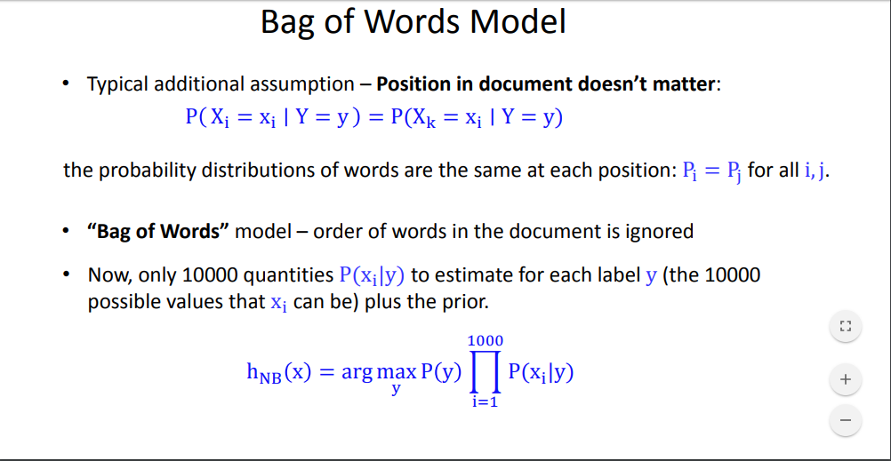

Slide 52
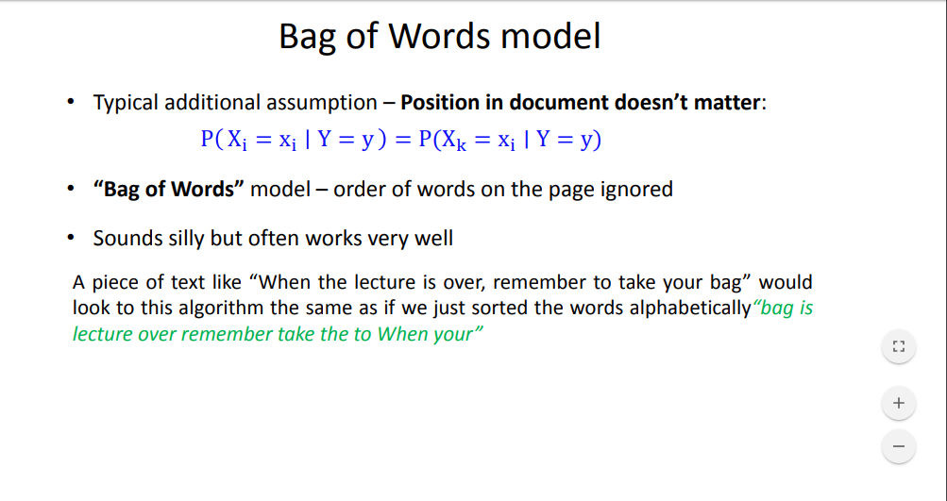

Slide 53
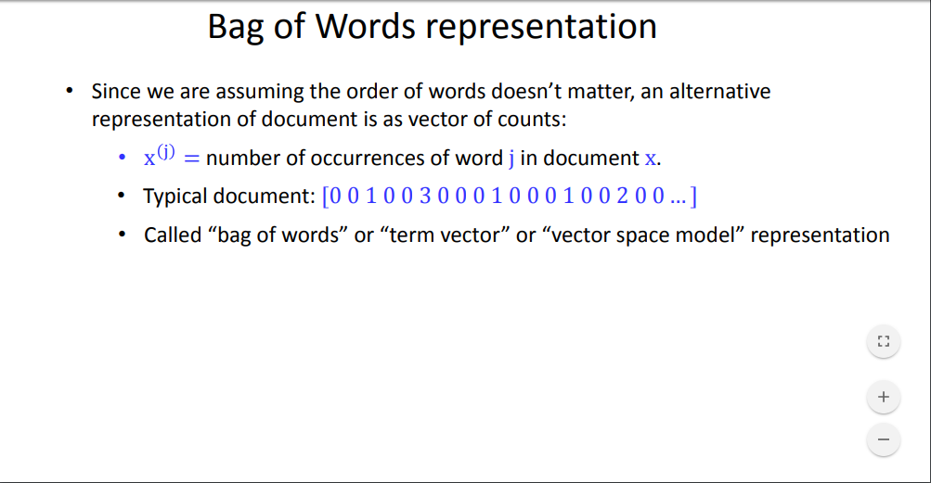

Slide 54
Twenty NewsGroups
Given 1000 training documents from each group Learn to classify new documents according to which newsgroup it came from
Naive Bayes: 89% classification accuracy
comp.graphics comp.os.ms-windows.misc comp.sys.ibm.pc.hardware comp.sys.mac.hardware comp.windows.x | misc.forsale rec.autos rec.motorcycles rec.sport.baseball rec.sport.hockey | alt.atheism soc.religion.christian talk.religion.misc talk.politics.mideast talk.politics.misc talk.politics.guns | sci.space sci.crypt sci.electronics sci.med

Slide 55
Gaussian Naïve Bayes Algorithm
A Gaussian Naive Bayes algorithm is a special type of NB algorithm.
It’s specifically used when the features have continuous values.
It’s also assumed that all the features are following a Gaussian distribution i.e, normal distribution.

Slide 56
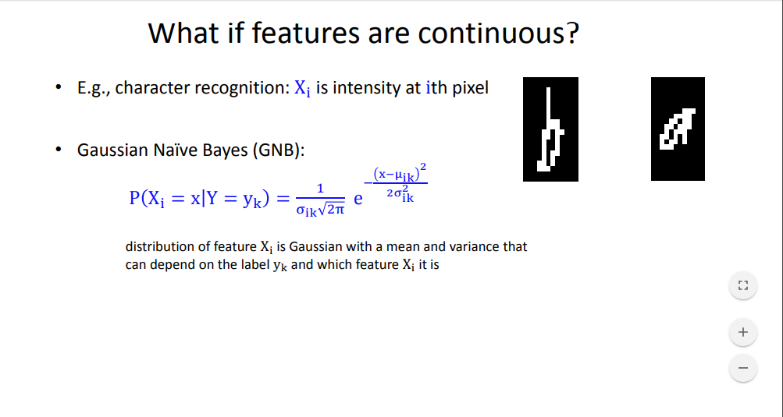
Estimating Parameters: X_{i} Continuous

Slide 57
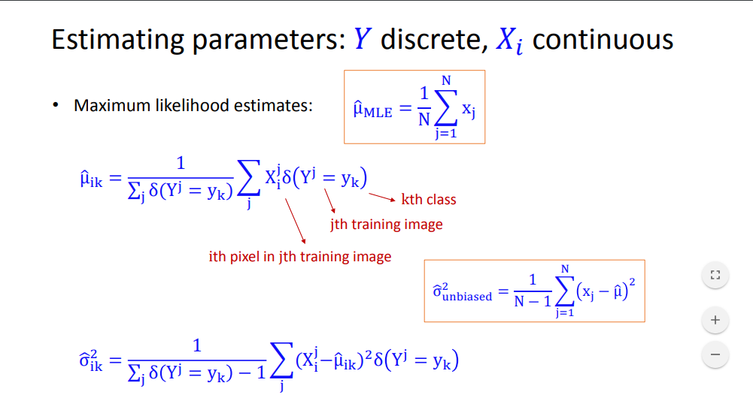

Slide 58
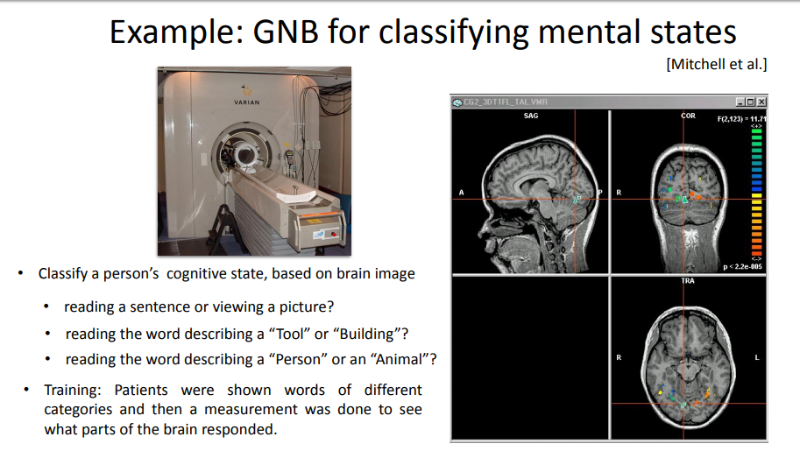

Slide 59
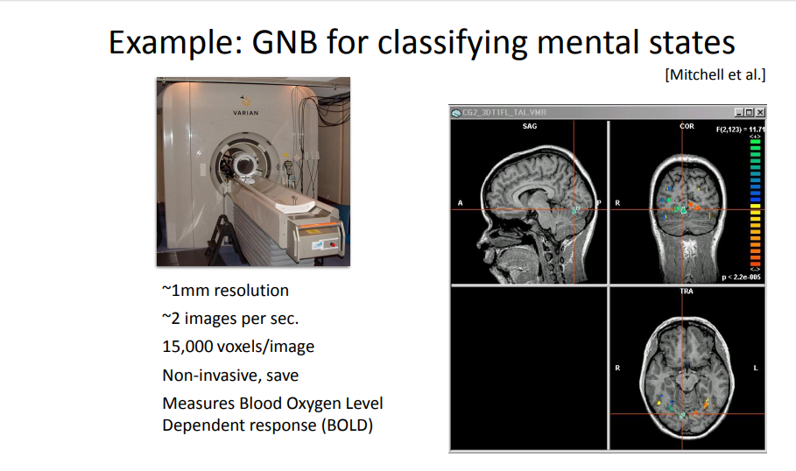

Slide 60
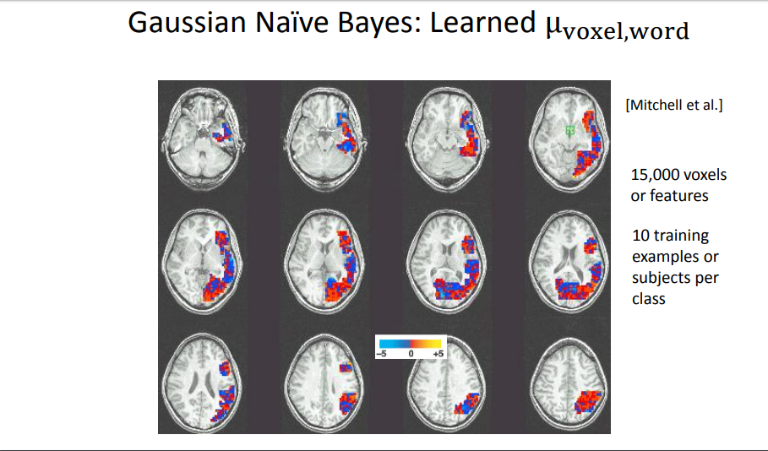

Slide 61
Naïve Bayes Python Implementation

Slide 62
References
Movie Review:
https://www.youtube.com/watch?time_continue=16&v=EGKeC2S44Rs
Spam mails by Prof. Andrew Ng:
https://www.youtube.com/watch?v=z5UQyCESW64
https://www.youtube.com/watch?v=NFd0ZQk5bR4
NLP by Prof. Dan Jurafsky, Stanford:
https://www.youtube.com/watch?v=Fmu65a0v6Sw
Text Classification in NLP using Naïve Bayes
https://medium.com/@theflyingmantis/text-classification-in-nlp-naive-bayes-a606bf419f8c
More on Probability
https://www.probabilitycourse.com/chapter1/1_0_0_introduction.php
Python Code
https://medium.com/@pragya_paudyal/classification-of-diabetes-using-naive-bayes-in-python-44385b279277
https://archive.ics.uci.edu/ml/datasets/Diabetes
https://www.sicara.ai/blog/2018-02-28-naive-bayes-classification-sklearn
https://programmerbackpack.com/naive-bayes-classifier-tutorial-in-python-and-scikit-learn/#:~:text=The%20sklearn%20library%20contains%20more%20than%20one%20Naive,on%20some%20types%20of%20data%2C%20while%20others%20don%27t.
https://scikit-learn.org/stable/modules/naive_bayes.html

Slide 63
Webinar and Quiz Schedule
Webinar #1 | Webinar #2 | Webinar #3 | Webinar #4 | Quiz-1 | Quiz-2 | Quiz-3
22/Sep/2020 | 20/Oct/2020 | 10/Dec/2020 | 7/Jan/2021 | 7/Oct/2020 | 16/Dec/2020 | 13/Jan/2021

Slide 64
In our next session
We will cover:
Bishop
4.1 Discriminant Functions,(4.1.1, 4.1.2)
4.3 Probabilistic Discriminative Classifiers,
4.3.1, 4.3.2 logistic regression
Difference between Generative and Discriminative classifier

Slide 65

Thank you for your time!!

